Slide 1
October 13, 2024
APLD Capstone Project #1
Kevin Astle, PharmD, BCIDP
Kelly Cochran, PharmD, BCPS
Lisa Hayes, PharmD, BCCCP, BCEMP
Jason Lancaster, PharmD, FCCP, BCPS
Carmen Smith, PharmD, BCPS
Notes:
10 min presentation with 2 min for questions

Slide 2
Project Goal
Develop a Plan for an effective audio resource for the BCPS Preparatory Course

Slide 3
Background
ACCP’s vision for the profession of pharmacy includes residency-trained, board-certified clinical pharmacists being accountable for medication optimization.
ACCP has provided board certification preparatory review courses in-person, as written text, and through recorded on-demand videos.
As podcasts and audiobooks continue to grow in popularity, an audio format may be appealing to clinical pharmacists looking for an alternative to the traditional formats.

Slide 4
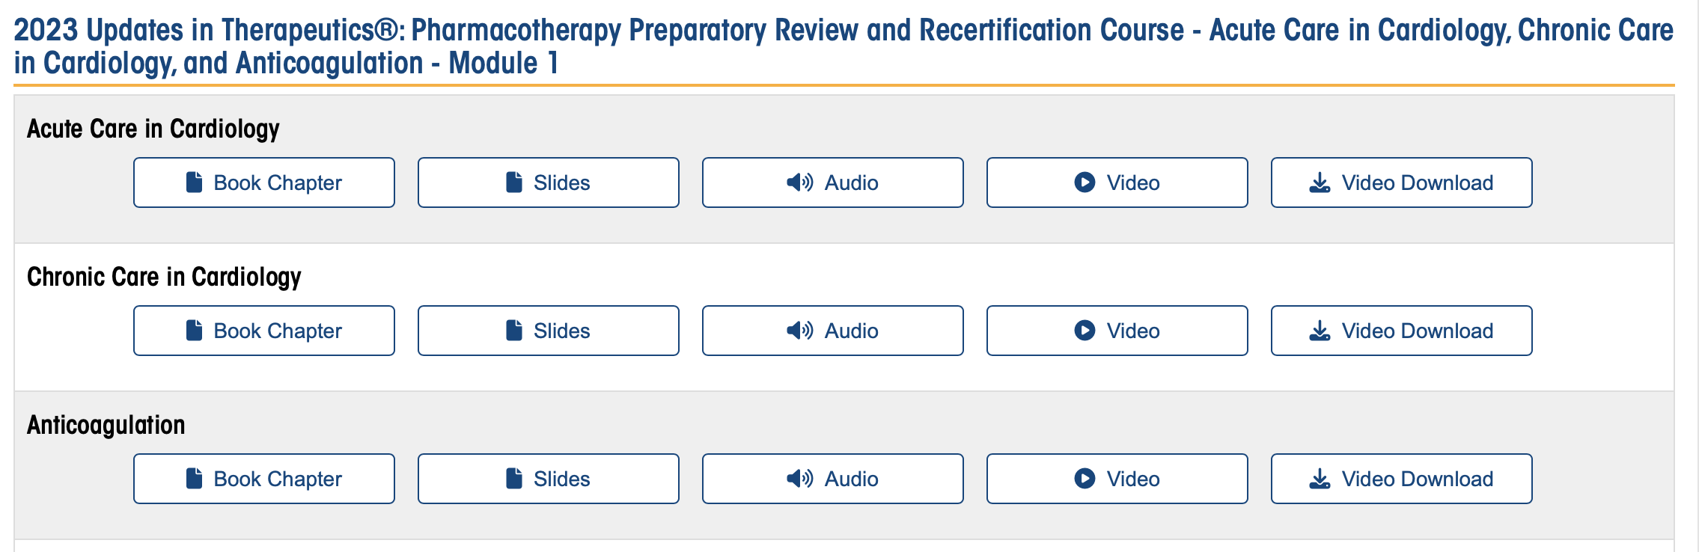
Current ACCP Audio Resources
Each chapter is a separate audio file (.mp3) that must be downloaded

Slide 5
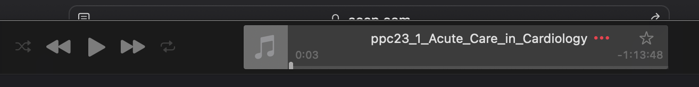
Current ACCP Audio Resources
Length of each chapter is ~1-1.5 hours
No ability to adjust speed of presentation
User must keep device screen open or playback stops
Does not keep place in audio if listener doesn’t complete listening in one session
No easy way to jump topics as no marks of topic breaks.

Slide 6
Capstone Project Charges
Utilize existing ACCP Pharmacotherapy Preparatory Review resources and research into podcasting best practices to develop a plan for an effective audio course
Include a plan with a timeline for program development, the curriculum, one or more sample recordings, and a marketing plan

Slide 7
Market Analysis
ASHP
  Podcasts offered weekly/semi-weekly
  8-12 minutes in length
  No cost or CE
APhA
  Podcasts hosted in partnership with iForumRx with APhA membership
  5 x 5 minute podcasts offered each month
    0.05 CE per podcast
SCCM
  Podcasts that offer interview/content expert discussions
  No cost or CE
Notes:
ASHP
○ Podcasts: currently offers weekly/semi-weekly podcasts (free of charge) on various topics of interest (clinical, operational, Mid-Year clinical meeting speaker series)
■ Typically 8-12 minutes in length and separated into 6 major sections (e.g. hot topics, therapeutic Thursdays)
■ No cost, open for all
■ Appear to be developed/hosted by ASHP
■ No CE credit offered
● APhA
○ Podcasts: partnered with iForumRx for distribution of content
■ Free with membership
■ Associated with 0.05 CE per podcast
■ Monthly 5 minute podcasts (5 total per month) over a variety of therapeutic highlights, best practices, and expert-driven sessions
● SCCM
○ Podcasts: Offers interview/content expert discussions
■ No cost
■ No CE credit

Slide 8
Goals of Survey to Past ACCP Prep Course Faculty & Participants
Determine how many are currently using audio resource with course
Determine goal length for content
Determine if users would support content that is additional cost beyond course
Determine if faculty would be willing to create additional content or CE questions

Slide 9
Survey
Survey sent to those who have been user and faculty for the BCPS Preparatory Course on two different dates
Responses
  74 users
  4 faculty
 | March 19th User | April 9th User | March 19th Faculty | April 9th Faculty
Sent | 3503 | 3500 | 22 | 22
Delivered | 3501 | 3499 | 22 | 22
Opened | 1968 (56.2%) | 1926 (55%) | 16 (72.7%) | 17 (77.3%)
Clicked | 68 (3.5%) | 48 (2.5%) | 3 (18.8%) | 2 (11.8%)
Notes:
HIDDEN slide as reference, if needed

Slide 10
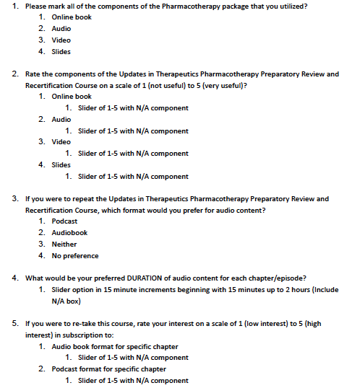
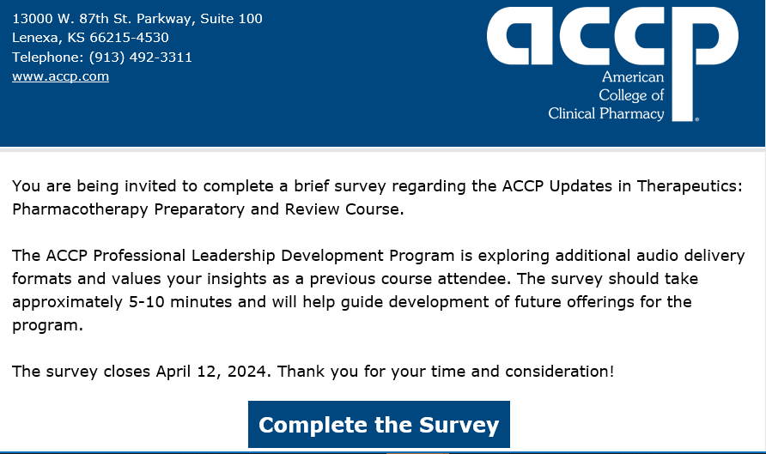
Notes:
Snapshot of first 5 questions

Slide 11
Survey Results
Audio and video files with lowest usage
  Also rated lowest utility 🡪 both ranging 2-5 versus 3-5 for other resources
Primary resource = online book
85% respondents in favor of additional audio formats
Small amount of faculty response (n=4) but overall positive
Notes:
Theme from comments
Improving the currently audio quality of the recordings
Preference for physical book as well, slides for every method of audio, additional assessment and problem-solving questions

Slide 12
Recommendations
Utilize current ACCP audio files from the BCPS Preparatory Course to develop a more user friendly audio accompaniment to course that would be included with cost of course
  Host on Spotify as a subscription-based podcast
  Chapter based recordings that would range in length from 30-60 minutes
  Allows for user to select playback speed
  Add bookmarks for topic breaks in chapter to allow user to skip content they already believe to be mastered
  Market audio addition as a component of Prep Course package

Slide 13
Steps for Setting Up a Podcast
Record Audio
Edit Audio
Host RSS feed
Stream Audio Files
Notes:
Record Audio. For our recommendations, the audio to be used in the “podcast” will be the same audio feed generated through the recording. Zoom, Teams, and other available platforms will be suitable. Ideally presenters will use high quality microphones to optimize audio output.
Edit Audio. Same process that is currently done could be done to edit podcast audio. Potentially removing background noise, pauses, filler words. Common platforms include Garageband for Apple products, Adobe, or Audacity. Free options available.
Host RSS Feed. With the RSS feed, there are options available for public (anyone with link can access or be shared to podcast platforms) or private (only those with link can access. Not publicly searchable). Most podcasts utilize the public feed option, including podcasts with intended restricted audiences, such as iForumRx. Most common RSS Host Site is PodBean which has various subscription levels ranging from $9/month (suitable for our purposes) up to $60/month. Most private RSS feeds are around $100/month but is not essential.
Stream Audio Files. Audio files can be streamed through a link embedded directly into the website (similar to the current video streaming option), as well as through any streaming platform such as Apple Podcasts, Google Podcasts, Spotify, etc.

Slide 14
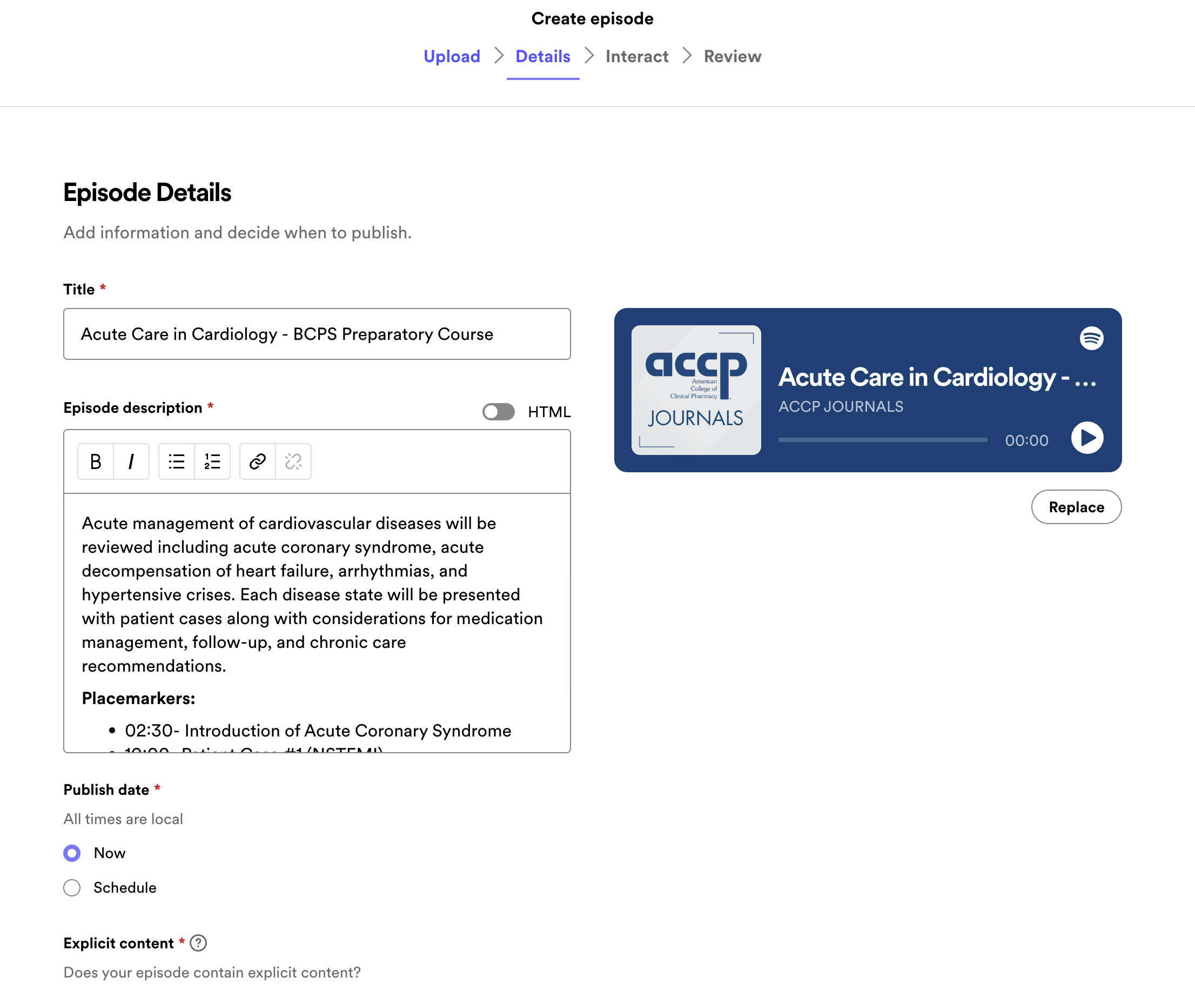
What Could it Look Like?
Providing the place markers will allow listener to move forward if they felt proficiency in certain areas and want to progress past that content
Spotify has a +15/-15 second tool to navigate to desired section
Notes:
**Sample picture on slide to be updated with a Prep Chapter example**

Slide 15
October 13, 2024
APLD Group Two Final Report​
Brittany Bissell Turpin, PharmD, PhD, FCCM, BCCCP
Pratish C. Patel, Pharm.D., FIDSA, BCIDP, AAHIVP
Radhika S. Polisetty, Pharm.D., BCIDP, AAHIVP, FIDSA
Taylor Steuber, Pharm.D., BCPS
Erin Thompson, Pharm.D., BCPS, BCACP

Slide 16
Background Information
The DEIA Task Force Phase II Action Plan includes a wide range of activities to support ACCP members, create and sustain an inclusive culture, and encourage more active engagement.
Objective 1.6 is to implement an outreach plan to engage with lapsed ACCP members to learn about their reasons for non-renewal. Reasons for non-renewal are likely to be multifactorial and may include but are not limited to issues of inclusion and belonging.
Learning from lapsed members is a common area of focus among associations.

Slide 17
Group Charge
Develop an outreach plan to engage with lapsed members and learn about reasons for non-renewal. The plan should include a detailed description of the information to be collected, as well as the process for contacting members and a form for collecting the information.

Slide 18
Methods
Requested a dataset of lapsed members
Analyzed the dataset to inform outreach plan
Developed outreach plan

Slide 19
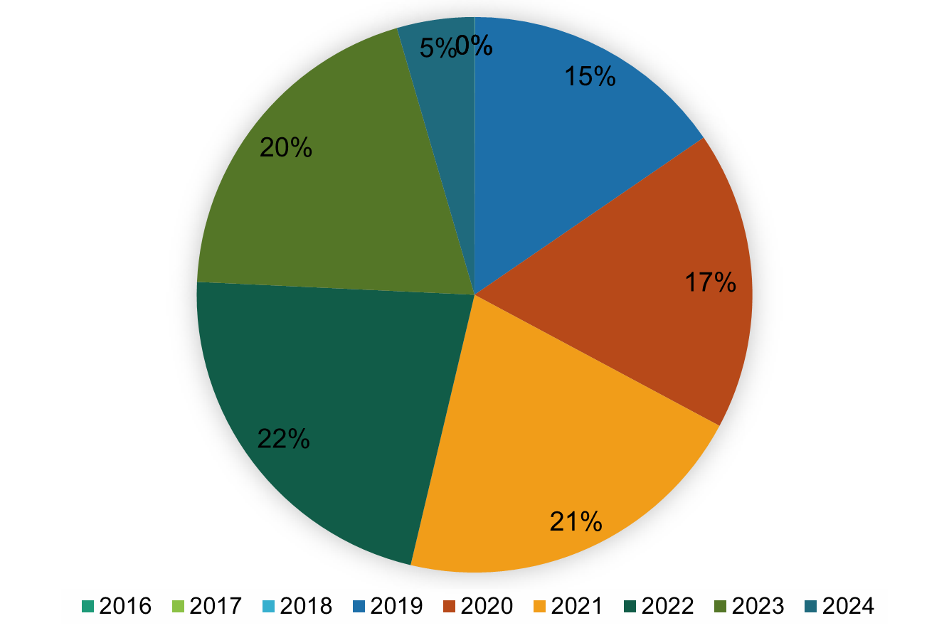
Data Assessment
Last Year of Membership
Number of membership years: 2.2 ± 5.0
  3.4 ± 6.2 excluding STU/RES members
Number of renewals: 4.4 ± 5.6
  5.4 ± 6.6 excluding STU/RES

Slide 20
Demographics and Characteristics
Age Group | Percent
18-25 | 2%
26-30 | 18%
31-35 | 22%
36-40 | 19%
41-45 | 13%
46-50 | 9%
51-55 | 6%
56-60 | 4%
61-65 | 3%
66-70 | 2%
>70 | 1%
Location | Percent
International | 2.07%
PUERTO RICO | 0.55%
New England | 4.40%
Middle Atlantic | 10.46%
East North Central | 13.95%
West North Central | 10.27%
South Atlantic | 21.12%
East South Central | 6.78%
West South Central | 7.44%
Mountain | 8.18%
Pacific | 14.78%
Practice Setting | Percent
Ambulatory Clinic | 9.18%
College of Medicine | 0.37%
College of Pharmacy | 21.64%
Community Hospital | 28.06%
Community Pharmacy | 6.05%
Contract Research Org. | 0.16%
Government Hospital | 5.71%
Home Health Care | 0.24%
Long Term Care | 0.66%
Managed Care | 1.36%
Mental Health Facility | 0.35%
Other Practice Locale | 6.24%
Pharmaceutical Industry | 1.98%
University Hospital | 17.98%
Career Title Designation
"Clinical pharmacist": 38.78%
"Other": 46.77%
All other ranged from
0.01% to 2.50%
Board Certification
34.42% were board certified
23.97% had BCPS certification
PRN Involvement
56% members of PRN
INFD, CRIT, AMBU PRNs most common, but large spread

Slide 21
Involved Lapsed Members
6% of members in at least 1 "involved role"
  Average of 7.1 ± 8.0 years as full members
  86.7% were PRN members
Involvement Category | Percent
Committee | 3.34%
PRN Officer | 0.63%
Board Service | 0.07%
Event Attended | 33.06%
Event Speaker | 1.90%
Academy | 1.90%
Student Membership | 37.18%
Resident Membership | 18.30%
Involved role = committee member, PRN officer, board service, event speaker, or academy participant (arbitrary definition)

Slide 22
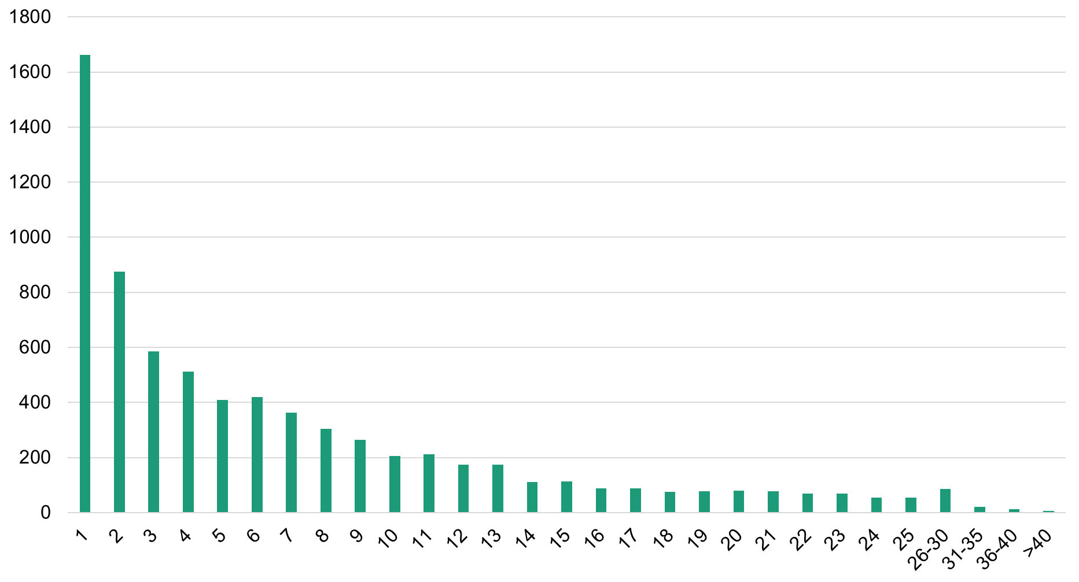
Number of Membership Years for Lapsed Members
Analyzed data​
Clear drop off in lapsed membership around years 1-3 and 7-8​
Requested additional data for all ACCP members (demographics, location, practice area, etc.)

Slide 23
Outreach Plan - Lapsed Member Survey
The purpose of the initial survey will be to collect comprehensive information about lapsed members and the reason for their non-renewal.
This will help us see if there are any patterns or trends in terms of demographics, specialty, area of practice or years of practice and try to recommend solutions
Based on initial data, ACCP to deploy two surveys via email:
  One survey to members who were only members 1-3 years
  One survey to members who were members >8 years
Ascertain ability/willingness to participate in focus group as part of survey
  This will remain anonymous with the use of a separate survey link
Survey results are gathered and reviewed by ACCP appointed committee, staff or task group

Slide 24
Sample Survey Questions
Approximately how long were you a member of ACCP (total number of years)
  1 year
  2 years
  3 years
  4-7 years
  8-10 years
  11+ years
When you were an ACCP member, what was the last membership type that you held:
  Retired Member
  Full Member
  Associate Member
  Affiliate Member
  Fellow Member
  Resident Member
  Student Member
How would you describe the overall culture of ACCP? (less than 100 words)
How can ACCP improve the membership experience?
Which of the following activities, events, or committees did you participate in as a member of ACCP (Check ALL that Apply):
  Committee
  PRN Officer
  PRN Membership
  Board Service
  Event Speaker
  ACCP Academy (Leadership & Management, Research & Scholarship, Teaching & Learning, Comprehensive Medication Management Implementation, Billing and Contracting for Outpatient Clinical Pharmacy Services)
  Annual Meeting
Do you have any other information you would like to share about your membership experience or decision to not renew your membership?
ACCP would like to offer XXX in exchange for select survey participants to assist as a focus group panelist. Would you be willing to be contacted by ACCP for this purpose?
  Yes
    Please share your contact information
      Phone
      Email Address
  No

Slide 25
Sample Survey Questions
Which of the following best describes the largest contributor in deciding not to renew your ACCP membership? (select one only)
  Relocation
  Change of job/career/business focus
  Retired
  It became too costly
  No tangible benefits
  Did not receive the expected value to justify the cost
  Decline in benefits or quality of benefits offered by the organization$
  Employer stopped paying membership subscription
  Not enough time to use the benefits
  Decided to join another pharmacy organization
  Involvement in other pharmacy organizations increased/took priority
  Other time commitments prevented involvement
  The group was not a fit/the right one for me
  Was not welcomed by the group
  Felt a lack of connection/engagement with the organization
List 2 things that you liked best about your membership experience?
List 2 things that you liked least about your membership experience?
If there were any other reasons you chose not to renew your ACCP membership? Please select and rank them in order. (You can choose a total of 5 if applicable. If none, select none/leave blank)
  Relocation
  Change of job/career/business focus
  Retired
  It became too costly
  No tangible benefits
  Did not receive the expected value to justify the cost
  Decline in benefits or quality of benefits offered by the organization
  Employer stopped paying membership subscription
  Not enough time to use the benefits
  Decided to join another pharmacy organization
  Involvement in other pharmacy organizations increased/took priority
  Other time commitments prevented involvement
  The group was not a fit/the right one for me
  Was not welcomed by the group
  Felt a lack of connection/engagement with the organization
  Feel the association no longer addresses my concerns
  Association was ineffective in representing the profession/clinical pharmacy
  Disagreed with the association’s national political/advocacy position

Slide 26
Outreach Plan- Focus Group
Focus group
  Questions and specific purpose to be determined based on survey results
    Understand the largest contributing factor for non-renewal
    Review trends between two survey groups for reasons for non-renewal
    Compare survey demographic information to lapsed member and ACCP membership at large information to determine if respondent sample was skewed
  Anticipate conducting two sessions
    “Good” lapse: competing organization membership, time constraints, change of practice area, membership cost, etc.
    “Bad” lapse: membership experience, lack of connection, poor value, organizational culture, etc.
  Sample questions
    What did you gain from your membership?
    Would you still recommend this association to friends and colleagues?
    Would you re-join in the future?
    What would encourage you to re-join?

Slide 27
October 13, 2024
APLD Group Two Final Report​
Brittany Bissell Turpin, PharmD, PhD, FCCM, BCCCP
Pratish C. Patel, Pharm.D., FIDSA, BCIDP, AAHIVP
Radhika S. Polisetty, Pharm.D., BCIDP, AAHIVP, FIDSA
Taylor Steuber, Pharm.D., BCPS
Erin Thompson, Pharm.D., BCPS, BCACP

Slide 28
Developing a Marketing Plan for the APLD Program
2023-2024 APLD Capstone Group 3

Slide 29
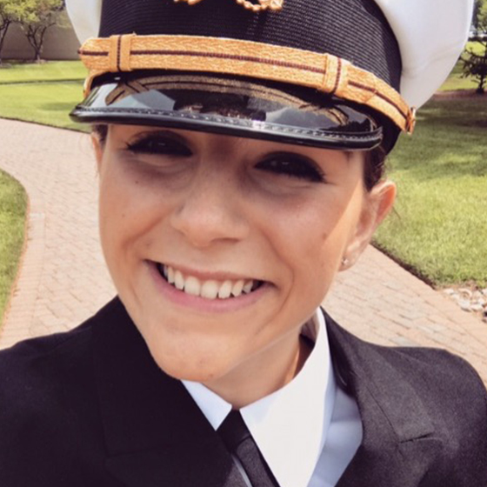
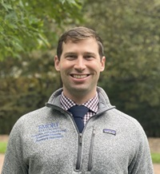
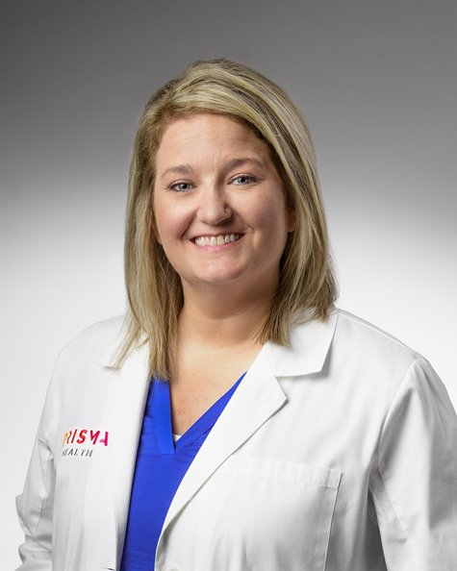
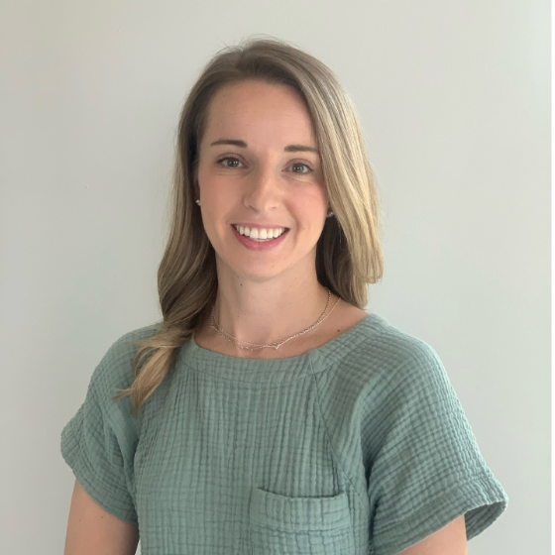
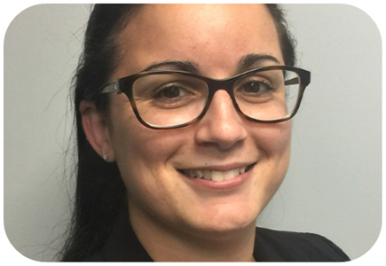
Capstone Group 3 Members
Madison Adams, Pharm.D., MHA, BCPS
Benjamin Albrecht, Pharm.D., BCIDP
Jenna Cox, Pharm.D., BCPS, BCCCP
Jennifer Hoh, Pharm.D., BCCCP, BCEMP
Melissa Santibañez, Pharm.D., FCCM, BCCCP

Slide 30
Learning Objectives
Describe rationale for developing a marketing plan for APLD program
  Based on inaugural 2022-2023 and current 2023-2024 APLD classes
Present timeline and progression for completion of APLD program marketing plan
Introduce continued opportunities for APLD program advertising

Slide 31
Charge
“Using material from the ACCP Professional Leadership Development program as a resource, in addition to your own experience as APLD members, the experience of previous APLD members, speakers, and mentors, develop a plan to market the program to ACCP members. The plan should highlight the unique nature of the program and provide examples of social media and website postings to promote the program to multiple groups within our membership, including our target audience of emerging leaders as well as more seasoned members who may have employees, younger colleagues, or mentees who would benefit from the program. In addition, the plan should include a timeline for issuing posts throughout the year.”

Slide 32
Marketing Plan Goals
[Goal 1] Showcase 2022-2023 APLD class
[Goal 2] Highlight 2023-2024 APLD class
[Goal 3] Develop future APLD recruitment materials
Target date: Apr-June 2024
Target date: longitudinal
Target date: Apr-June 2024
Social media posts, ACCP newsletter, APLD website
Social media posts, testimonials, APLD website
Social media posts, ACCP newsletter, APLD website
Notes:
Target Goals 1 and 3 before the call for applications for next cohort 2024-2025 (~April-June 2024).
Goal 2 would be longitudinally targeted during the 2023-2024 year.

Slide 33
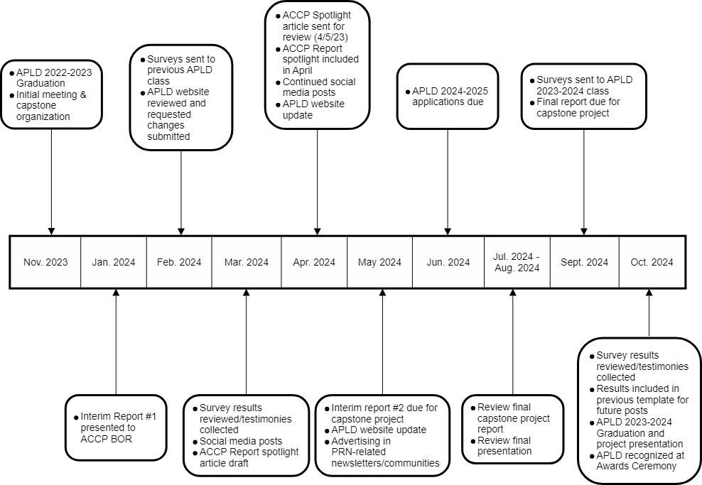
Timeline of Marketing Plan Implementation

Slide 34
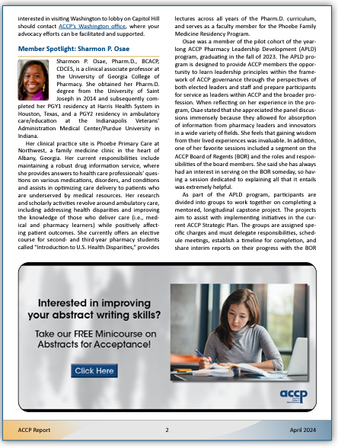
Goal 1: Showcase 2022-2023 APLD Program Class
REDCap survey developed and distributed to 2022-2023 APLD program graduates in Feb 2024
  Also requested video testimonials
  Received 8 completed responses
    Added to APLD program website
    Posted on ACCP social media accounts weekly Apr-May 2024
    Included in ACCP Member Spotlight in Apr 2024 PRN Report
Final capstone presentations from 2022-2023 cohort posted on APLD program website in Apr-May 2024
  Prior to opening the 2024-2025 call for applications for 2024-2025 cohort

Slide 35
Goal 2: Highlight 2023-2024 APLD Program Class
Longitudinal goal
REDCap surveys were distributed to 2023-2024 APLD program cohort in Sep 2024
  Testimonials will continue to be shared/posted as before

Slide 36
Goal 3: Develop Future APLD Program Recruitment Materials
APLD program website updated with ACCP input to improve user experience
  Enhanced user aesthetics
  Showcased past capstone projects
  Provided links to graduates’ testimonials
  Compared APLD program to ACCP Leadership and Management Academy
APLD program graduate testimonials posted weekly on ACCP social media
Personalized recruitment emails sent to each PRN during 2024-2025 call for applications
Outgoing recommendations
  Continue increasing APLD program visibility at ACCP Annual Meetings
    Including showcasing APLD program graduates at awards ceremony
  Post final presentations from each graduating class to continue highlighting APLD program capstone projects

Slide 37
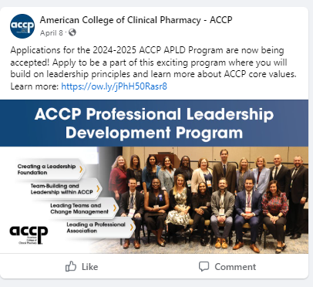
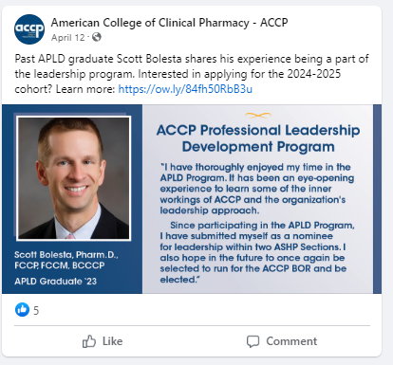
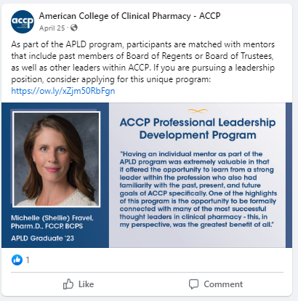
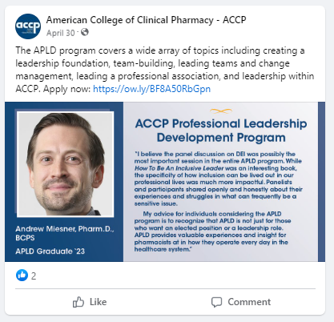
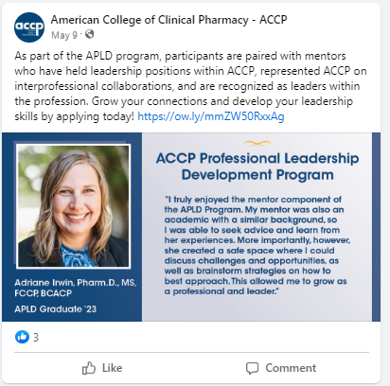
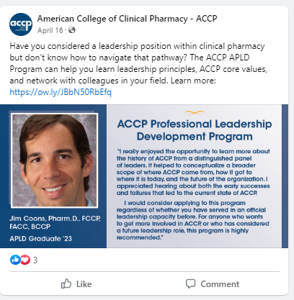
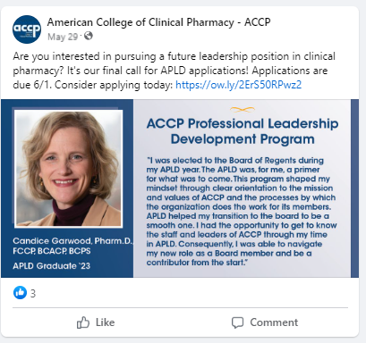
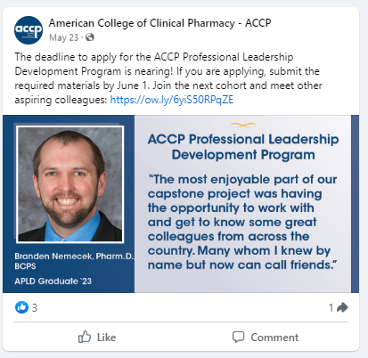
2022-2023 Graduate Testimonials

Slide 38

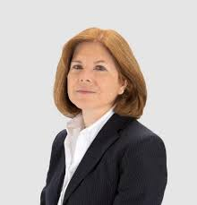
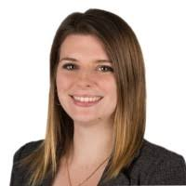
Acknowledgments:
Capstone Project Advisors
Marcia Buck, Pharm.D., FCCP, FPPA, BCPP
ACCP Director of Clinical Practice Advancement
Britni Downey, B.A.
ACCP Senior Marketing and Communications Specialist

Slide 39

Developing a Marketing Plan for the APLD Program
2023-2024 APLD Capstone Group 3
Check out the NEW APLD website!

