Slide 1
October 18, 2026
ACCP Professional Leadership Development Program
2026 Capstone Presentations and Graduation Ceremony

Slide 2



APLD GROUP 1 CAPSTONE PROJECT
ACCP Awards Process Video/Graphic
Final Report | 2025–2026
2026 ACCP Annual Meeting

Slide 3
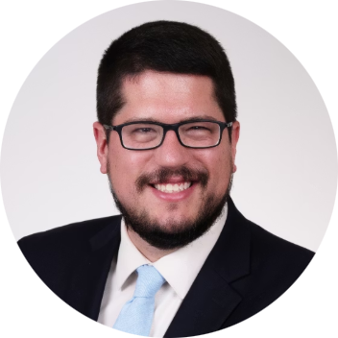
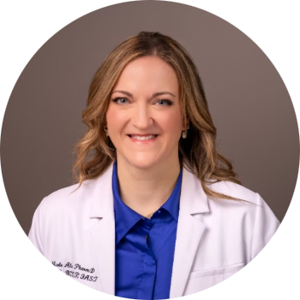
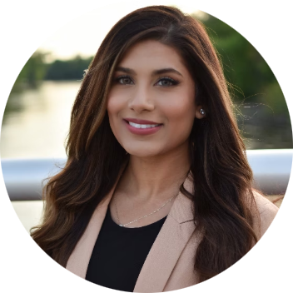
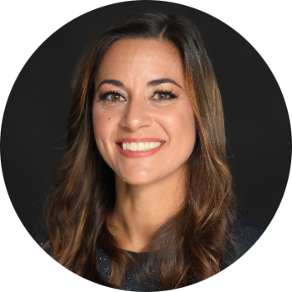

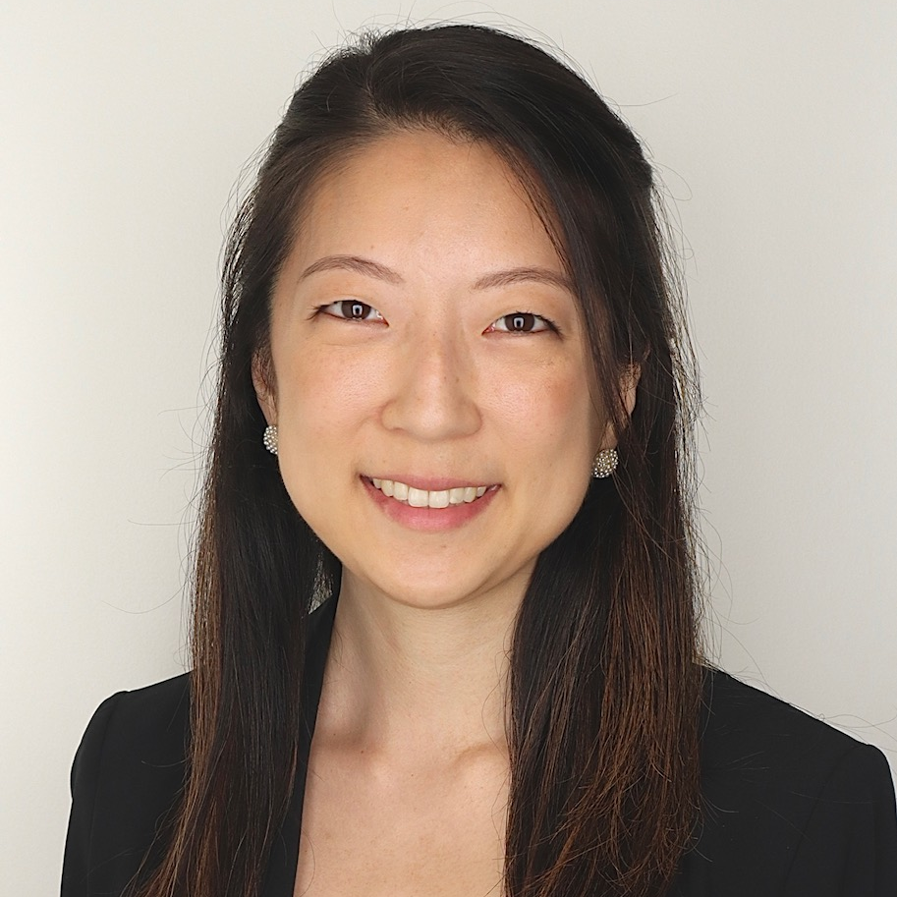
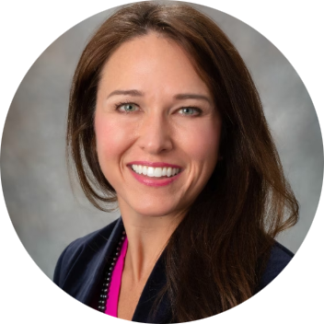

Project Team
Tom Achey
Nicole Alvey
Faria Chaudhry
Julie Ehret
Samantha Jellinek-Cohen
Michelle Jeon
Heather P. Whitley
Awards Committee Orientation:
Melanie Claborn and Paul Gubbins (November 7, 2025)
Project Advisor: Amie Brooks
2026 ACCP Annual Meeting

Slide 4

Project Charge and Purpose
Identified Need
The ACCP DEIA and Awards Committees identified a need for a practical, accessible resource explaining the ACCP awards nomination and selection process.
Project Charge
Create a graphic and/or video detailing the Awards Committee process with the goal of increasing transparency for nominators and candidates.
Proven Precedent
Publication of award rubrics on the ACCP website was associated with improvements in nomination letter quality, suggesting a clear process guide could further increase the number, quality, and diversity of nomination packets.
2026 ACCP Annual Meeting

Slide 5
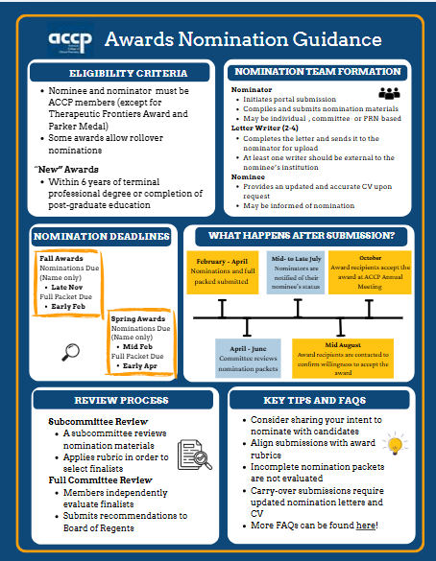
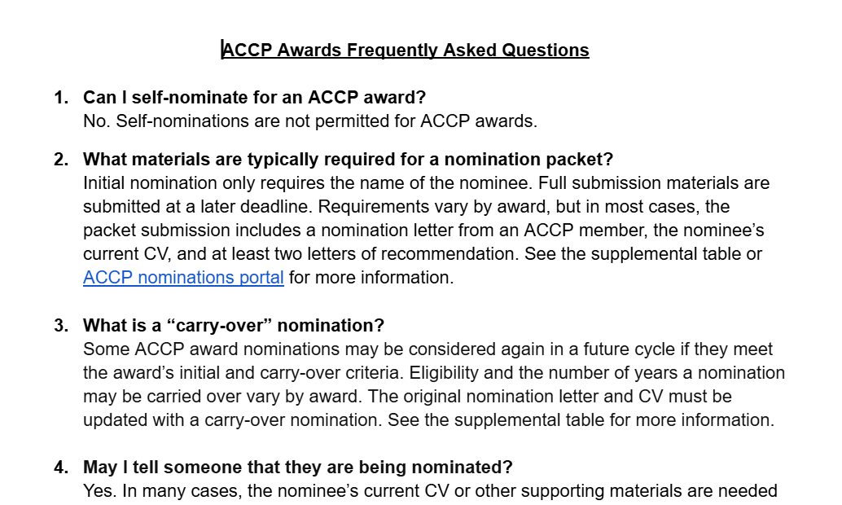
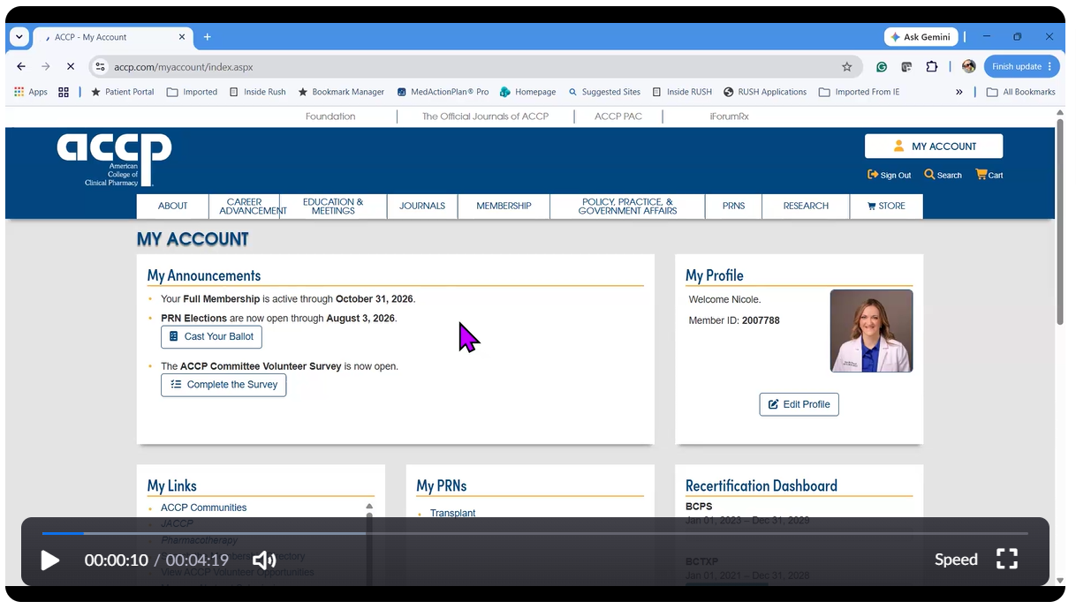
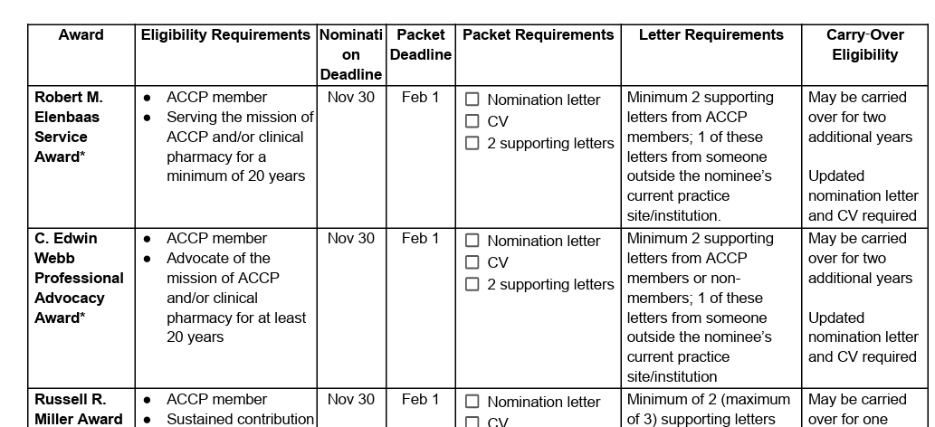
What We Built: Four Core Deliverables
The group developed a one-page infographic as a concise, high-level roadmap for nominating an individual for an ACCP award, complemented by an FAQ document, awards summary table, and a how-to nominate video.
One-Page Infographic
FAQ
Awards Summary Table
How-to Nominate Video
Six-part roadmap for the ACCP award nomination process
Eligibility, submission requirements, award distinctions, and tips for strong nomination packets
Side-by-side comparison of deadlines, requirements, letters, and rollover eligibility
Step-by-step walkthrough of submitting a nomination through the ACCP Nominations Portal
2026 ACCP Annual Meeting
Notes:
The original text below:
One-page infographic: A concise, high-level roadmap for nominating an individual for an ACCP award, organizing the process into six major content areas.
FAQ document: Provides additional explanation and links to relevant ACCP website resources, addressing eligibility criteria, submission requirements, distinctions among awards, and practical guidance for strong nomination packets.
Awards Summary Table: A quick-reference comparison of eligibility requirements, nomination deadlines, packet deadlines, packet requirements, letter requirements, and rollover eligibility for all awards.
How-to Nominate Video: A step-by-step guided video with accompanying written handout walking through the nomination process in the Nominations Portal on the ACCP website

Slide 6
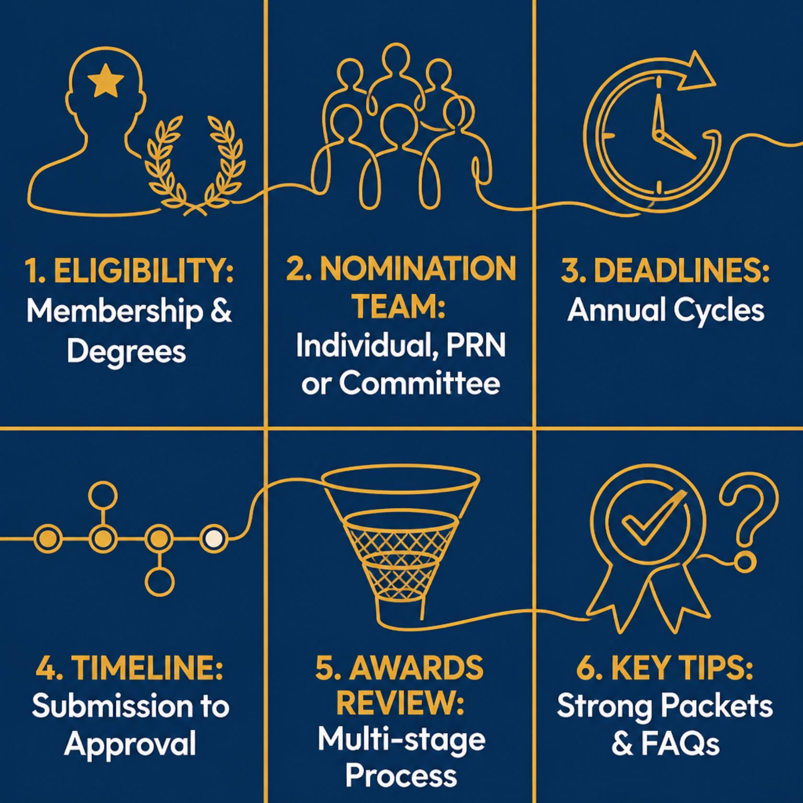
Content Framework
2026 ACCP Annual Meeting
Notes:
We organized the resource around six questions nominators most need answered.
Eligibility Criteria — Membership requirements, 'new' award distinctions, terminal-degree considerations, and rollover nominations
Nomination Team Formation — Guidance and membership requirements for PRN-based, individual, or committee nominations
Nomination Deadlines — Key deadlines and annual award cycles, including awards selected one year in advance
Nominations and Awards Timeline — A step-by-step overview from submitting a nominee's name through packet compilation to post-submission steps
Awards Review Process — Timeline clarification on multi-stage review, including subcommittee finalist selection, full committee vote, and Board approval
Key Tips and FAQs — Recommendations and tips for submission

Slide 7
Key Tips for Strong Nomination Packets
Align With Award Rubrics
Update Carry-Over Packets
Review ACCP's publicly available scoring rubrics before writing; they directly shape finalist selection.
Refresh the nomination letter and CV each cycle for rollover nominations.
Communicate Intent Early
Submit Complete Packets
Notify the nominee upfront so their CV and supporting materials can be gathered in time.
The Awards Committee reviews only what is submitted; no additional information will be requested.
2026 ACCP Annual Meeting

Slide 8
Summary of Information Covered in the FAQ Document
Nomination Process
Who can nominate
Initial information required
Carry-over nominations
Nomination Packet
Nomination materials required
Changes to submission
Letters of recommendation
Submission Tips
Timeline of nomination cycles
ACCP nomination portal questions
Links to Additional Resources
ACCP award descriptions & rubrics
Past award recipients
Nomination portal
Supplemental awards summary table highlights for each ACCP award:
Eligibility requirements
Nomination & packet deadline
Packet requirements
Supporting letter requirements
Carry-Over Eligibility
2026 ACCP Annual Meeting

Slide 9

Project Outcomes and Evaluation
The project resulted in a structured, user-centered framework for explaining the ACCP awards process, bringing together information that prospective nominators may otherwise need to locate across multiple resources.
Infographic Access and Downloads
Changes in Nomination Volume
Track how often the infographic is accessed or downloaded from the ACCP website.
Monitor increases in nominations submitted across
award cycles.
Diversity of Nominators and Nominees
Awards Committee Perceptions
Assess whether the resource broadens and diversifies
participation over time.
Gather committee feedback on nomination quality and process efficiency post-implementation.
2026 ACCP Annual Meeting

Slide 10
Recommended Next Steps for ACCP
Update the Awards Webpage
Combine Award Descriptions, Criteria and Rubrics
Replace the existing URL under "About: Awards" with the content developed by this group, modeled after the existing FCCP page for a more organized and user-friendly format.
Merge the current award criteria and rubrics into a single resource for each award, with criteria presented first followed by the corresponding rubric, to improve clarity for potential nominators.
Automate Recipient Tracking
Highlight Previous Award Recipients
Explore developing an automated process for maintaining a record of previous award winners to streamline recordkeeping and ensure recipient information remains current.
Add headshots of past award winners to the nomination/awards webpage to recognize recipients and provide greater visibility to the awards and their history.
2026 ACCP Annual Meeting

Slide 11
Conclusion
From identifying barriers to creating practical tools for better nominations
THE NEED
WHAT WE CREATED
INTENDED IMPACT
A practical, accessible
explanation of the
ACCP awards nomination
and review process.
Transparency
WATCH & LEARN
↑
QUICK START
AT-A-GLANCE
Clearer understanding
of the process
One-page infographic
+ FAQ
Awards-specific
quick-reference table
Nominations Portal
process video
↓
Perceived barriers
Less uncertainty
about how to nominate
Practical overview of the nomination and review process
Criteria and rubrics organized for easy comparison
Step-by-step demonstration of submitting a nomination
↑
Quality & inclusion
Stronger, more diverse
nomination packets
Iterative development → subgroup review → advisor feedback → full-group refinement
ONE PROJECT • THREE PRACTICAL TOOLS • A MORE TRANSPARENT PATH TO RECOGNITION

Slide 12
APLD GROUP 1 CAPSTONE PROJECT
ACCP Awards Process Video/Graphic
Final Report | 2025–2026
2026 ACCP Annual Meeting

Slide 13
Developing Opportunities and Resources for Residency Program Directors, Coordinators, and Preceptors
Advisor: Marcia Buck, PharmD, FCCP, FPPA, BCPPS
Jennifer Adema, PharmD, MBA, BCPS
Jason Chau, PharmD., MSCS, BCPS, BCACP, BCGP
Jonathan Hughes, PharmD, BCACP
Haley N. Johnson, PharmD, BCPS
Dominique Mark, Pharm.D., BCPS, BCPPS
Alyssa Robertson, Pharm.D., M.Ed., BCPS, BCCCP, BCEMP
Sarah E. Wheeler, Pharm.D., BCACP, CDCES
Notes:
Last modified: 09/20/2026
No Presenter Notes

Slide 14
Artificial Intelligence Disclaimer
Gemini (Google) was used in the development of this presentation in July 2026.

Slide 15
Background and Charge
Strategic Direction 2.2.2 of the ACCP Strategic Plan calls for the College to “develop opportunities for networking and support of residency program leaders”.
Charge Summary:
Develop a list of residency program directors (RPDs) and/or coordinators to serve as a survey sample utilizing the ACCP Directory of Residencies, Fellowships, and Graduate Programs.
Create a survey to ascertain the unmet needs of residency program leaders.
Based upon the results of the survey, create a strategized approach to support residency leaders and preceptors.

Slide 16
Methods
StrengthsFinder
Used team’s Top 5 Strengths to determine how to best leverage our unique skills and areas of expertise
  Used AI to help delineate team member roles and project tasks based on strengths
Directory Access Work
Identified available ACCP Directory data of residency programs and developed a survey distribution list (~1,300 contacts)
Survey Creation:
Performed environmental scan/gap analysis
Designed, refined, and finalized survey instrument
Established survey content, logistics, and distribution strategy

Slide 17
Environmental Scan
Completed environmental scan to determine what information has already been provided from other professional healthcare organizations.
Common themes from organizations included:
Preceptor toolkits with articles and references
Preceptor certificate programs
Webinars, additional resources such as CE presentations, publications
Mentorship, wellness and resiliency resources

Slide 18
Environmental Gap Analysis
Identified potential areas ACCP could uniquely cover or gaps in current offerings.
Role-specific preceptor development
  Clinical, academic, research, etc.
Advanced assessment & feedback for clinical reasoning
  Assessing knowledge vs clinical judgement
Precepting in outcomes-driven practice
  How to teach clinical reasoning when patient impact is indirect but real
Mid- to late-career preceptor sustainability
Scholarly precepting
  Turning teaching into publishable work
Difficult conversations between preceptors and institutions
  Advocating for preceptors & learners
Precepting outside traditional residency models
Peer-to-peer problem solving community
  Living document library & practical discussion threads
Teaching clinical uncertainty and ambiguity
Precepting across interprofessional and non-pharmacy teams
  Extending beyond pharmacy-centric models

Slide 19
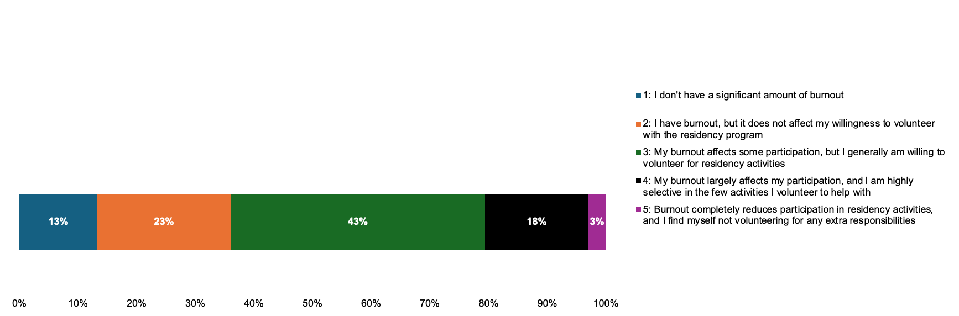
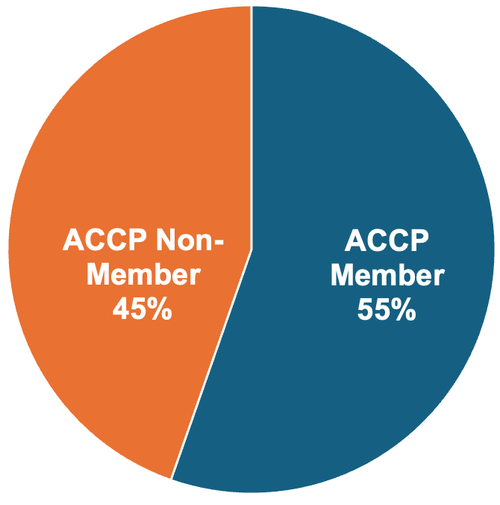
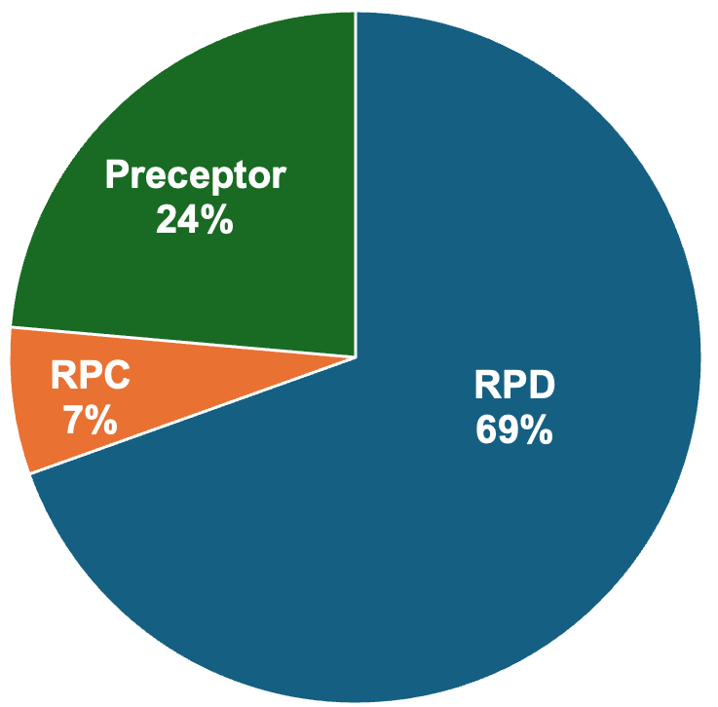
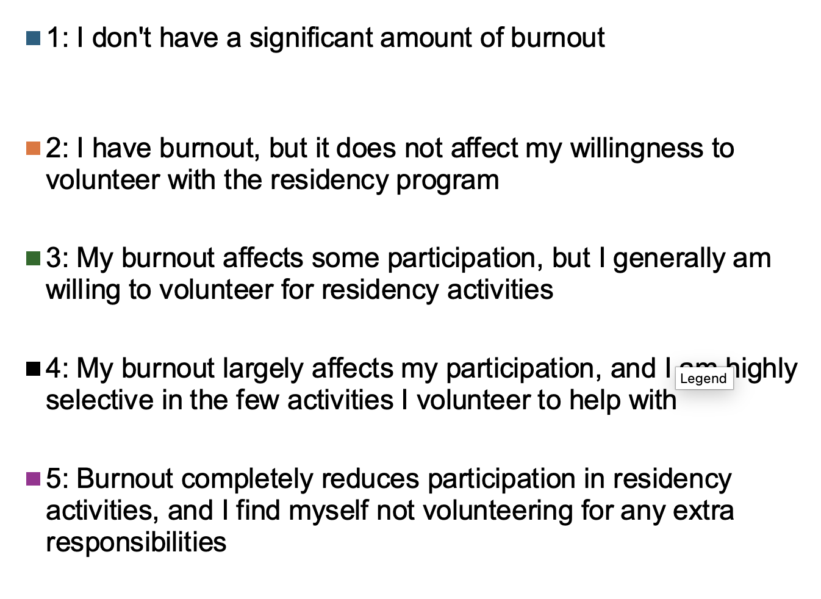
Survey Results: Demographics
233 residency program leader responses evaluated

Slide 20
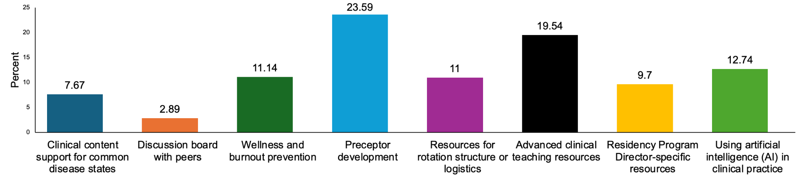
Survey Results:
Resources Addressing Areas of Need
Top Unaddressed Areas of Preceptor Development:
Residents Who Fail to Progress
Balancing Clinical Services vs Precepting
Program Sustainability

Slide 21
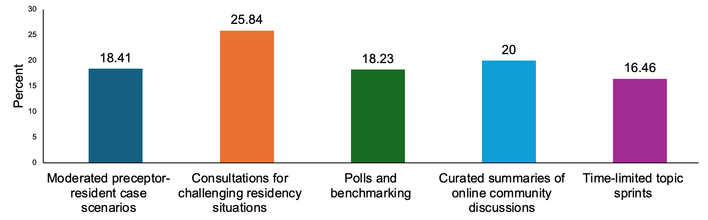
Survey Results:
Valued Online Community Features
88% are willing to share resources

Slide 22
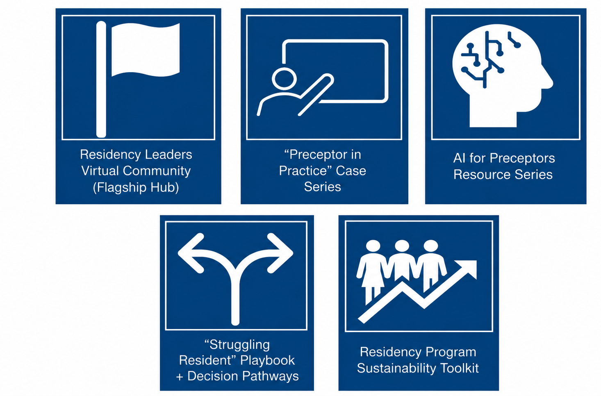
Brainstorm Proposals
Final Resource Proposals
Proposed Resources:
1. Residency Leaders Virtual Community (Flagship Hub)
2. “Preceptor in Practice” Case Series (Monthly)
3. Rapid-Access Preceptor Toolkit
4. Residency Leader Peer Advisory Groups (Cohorts)
5. Resident Who Fails to Progress Playbook + Decision Pathways
6. AI for Preceptors Resource Series
7. Preceptor Workload Optimization Lab
8. Residency Program Sustainability Toolkit
9. “Ask an RPD” On-Demand Consultation Service
10. National Residency Leader Roundtables (Quarterly)

Slide 23
Overall Recommendation:
Residency Leaders Virtual Community
At the core of the community will be a discussion board containing initial prompts designed to spark engagement around common pain points in residency leadership.
Curated resources to be housed in community library:
“Preceptor in Practice” Case Series
AI for Preceptors Resource Series
Resident Who Fails to Progress Playbook & Decision Pathways
Residency Program Sustainability Toolkit

Slide 24
“Preceptor in Practice” Case Series
Area of Focus: Preceptor Development
Key Components:
Interactive, case-based learning for preceptors and residency leaders
Focus on real-world challenges commonly encountered in practice
  Examples: resident progression/remediation, constructive/difficult feedback, balancing learner autonomy and preceptor roles, conflict management, workload
Flexible delivery through virtual sessions and/or online discussion forums

Slide 25
AI for Preceptors Resource Series
Area of Focus: Preceptor Development
Key Components:
Practical Tasks
Short modules and tip sheets focused on daily precepting workflows, case building, and efficient feedback delivery.
AI Prompt Library
Ready-to-use workflows and prompts for creating custom teaching questions, journal club guides, and development plans.
Case-Based Guidance
Clear boundary mapping detailing appropriate and inappropriate AI usage scenarios across clinical and academic settings.

Slide 26
Resident Who Fails to Progress Playbook and Decision Pathways
Area of Focus: Clinical Growth and Accountability
Key Components:
Clinical Growth:
  Therapeutic knowledge and application
  Efficiency and task prioritization
  Clinical reasoning and clinical thinking
  Communication with the multidisciplinary team
Accountability:
  Time management
  Receptiveness to feedback
  Self-awareness and reflective practice

Slide 27
Residency Program Sustainability Toolkit
Area of Focus: Enhancing Experiences and Justification for Financial Support
Key Components:
Toolkit: framework, evidence based performance tools, and practices to support preceptor engagement and retention of preceptors
  How to decrease administrative burden for RPDs and RPCs
Enhancement of Residency Learning Experiences: more standardization/templates
  Preceptor development
  Implementation of preceptor and resident feedback
  Resident and preceptor resiliency
Justification for Financial Support:
  Documentation for resident/preceptor interventions, prevention of ADRs
  Utilization of residents for expansion of clinical services

Slide 28
Executive Summary
THE CHALLENGE
High Burnout & Support Gaps: Survey data from 233 participants reveals widespread distress across pharmacy residency leadership roles.
87% of respondents reported experiencing burnout, with 21% indicating it directly impacted their active participation in residency activities.
OUR APPROACH
APLD Capstone Project #2: Aligned with ACCP Strategic Direction 2.2.2 to build actionable resources for directors, coordinators, and preceptors.
Targeted Needs Assessment: Identified critical priorities, including preceptor development, clinical teaching resources, and AI implementation.
RECOMMENDATIONS
Five Strategic Resources:
• Virtual Community
• "Preceptor in Practice" Cases
• AI for Preceptors Series
• Resident Who Fails to Progress Playbook
• Sustainability Toolkit

Slide 29
Developing Opportunities and Resources for Residency Program Directors, Coordinators, and Preceptors
Advisor: Marcia Buck, PharmD, FCCP, FPPA, BCPPS
Jennifer Adema, PharmD, MBA, BCPS
Jason Chau, PharmD., MSCS, BCPS, BCACP, BCGP
Jonathan Hughes, PharmD, BCACP
Haley N. Johnson, PharmD, BCPS
Dominique Mark, Pharm.D., BCPS, BCPPS
Alyssa Robertson, Pharm.D., M.Ed., BCPS, BCCCP, BCEMP
Sarah E. Wheeler, Pharm.D., BCACP, CDCES

Slide 30
ACCP Professional Leadership Development Program
Graduation
Miranda R. Andrus, Pharm.D., FCCP
Marcia L. Buck, Pharm.D., FCCP, FPPA, BCPPS

Slide 31
Our Mentors
Larissa H. Cavallari
Jennifer N. Clements
Erica F. Crannage
M. Lynn Crismon
Elizabeth A. Farrington
Tracy Hagemann
Judith Jacobi
Tyree Kiser
Eric MacLaughlin
Shawn McFarland
Jean Nappi
Suzanne Nesbit
Edith Nutescu
Robert B. Parker II

Slide 32
Our Faculty
Miranda R. Andrus
John M. Allen
Julie Wright
Amie D. Brooks
Marcia L. Buck
Debbie C. Byrd
Kelly Caudle
Allison M. Chung
M. Lynn Crismon
C. Lindsay DeVane
Elizabeth A. Farrington
Stuart Haines
Joanna Q. Hudson
Judith Jacobi

Slide 33
Our Faculty
Paul T. Kelly
Tyree H. Kiser
Jimmi Hatton Kolpek
Michael S. Maddux
Sarah E. McBane
M. Shawn McFarland
John E. Murphy, III
Suzanne A. Nesbit
Robert B. Parker, II
Marc Scheetz
Sharon See
Keri A. Sims
Kathy D. Pham
James E. Tisdale

Slide 34
Our 2025-2026 APLD Graduates
Thomas S. Achey, Pharm.D., MS, BCPS, BCSCP, FASHP
Jennifer Adema, Pharm.D., MBA, BCPS
Nicole R. Alvey, Pharm.D., BCPS, BCTXP, FAST
Jason Q. Chau, Pharm.D., MSCS, BCPS, BCACP, BCGP
Faria Chaudhry, Pharm.D., BCPS, BCACP
Julie A. Ehret, Pharm.D., BCPS, AACC
Jonathan Hughes, Pharm.D., BCPS, BCACP, FCCP

Slide 35
Our 2025-2026 APLD Graduates
Samantha P. Jellinek-Cohen, Pharm.D., BCPS
Michelle M. Jeon, Pharm.D., BCACP, AAHIVP
Haley N. Johnson, Pharm.D., BCPS
Dominique Mark, Pharm.D., BCPS, BCPPS
Alyssa Robertson, Pharm.D., M.Ed., BCPS, BCCCP, BCEMP
Sarah E. Wheeler, Pharm.D., BCACP, CDCES
Heather P. Whitley, Pharm.D., BCPS, CDCES, FCCP

Slide 36
Thank you!

